Slide 1
Muscles of the abdominal wall

Slide 2
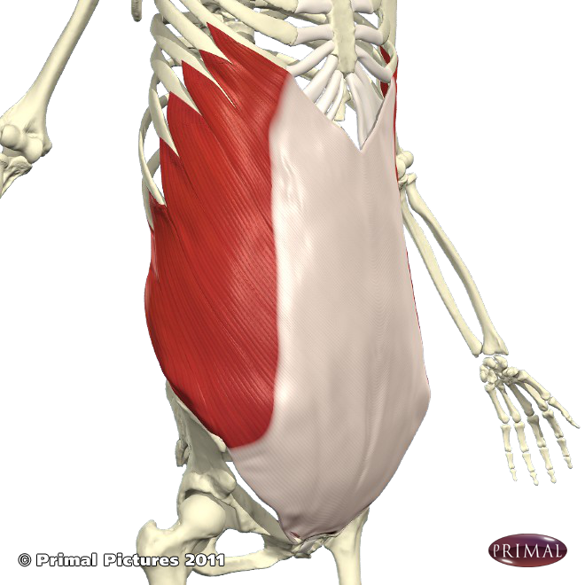
External oblique
This is the most superficial layer.
Origin: Ribs & iliac crest
Insertion: Pubis & front of iliac spine
Rotates the trunk to opposite side (assisted by internal oblique & transversus abdominis)
Assists with elimination and forced expiration

Slide 3
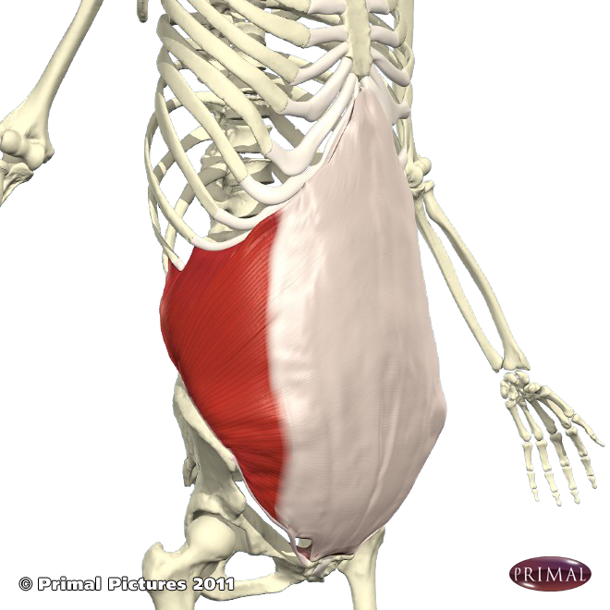
Internal oblique
This is the middle of the three layers of the anterior lateral abdominal wall.
Origin: Iliac crest & inguinal ligament
Insertion: ribs, xiphoid process, pubic crest
Rotates the trunk to the same side
Assists in elimination & forced expiration

Slide 4
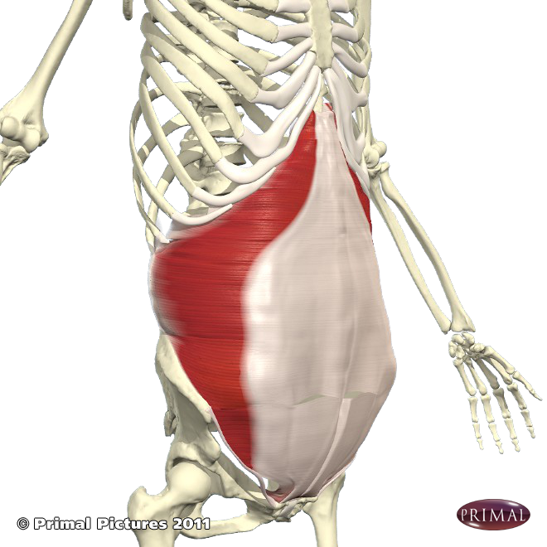
Transversus abdominis
This forms the deepest layer of the anterior lateral abdominal wall.
Origin: Ribs, iliac crest, inguinal ligament
Insertion: xiphoid process, fuses with posterior layer of internal oblique
Assists with elimination & forced expiration

Slide 5
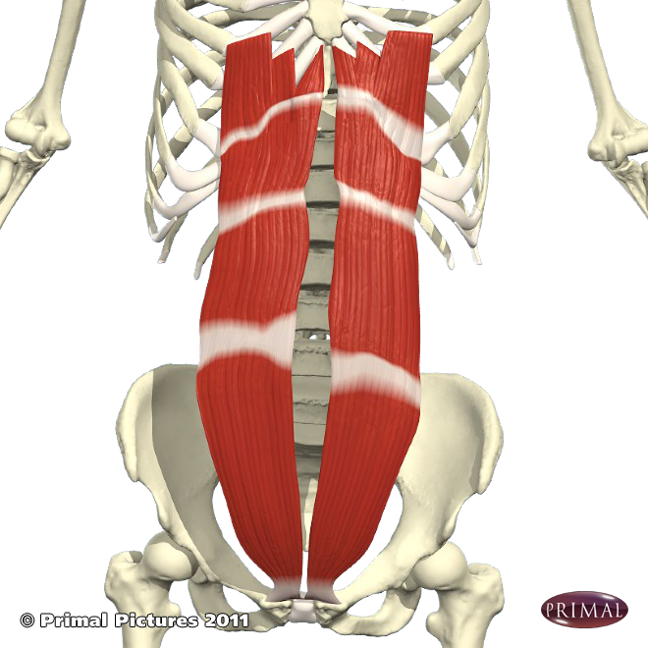
Rectus Abdominis
Origin: pubis symphysis
Insertion: xiphoid process & costal cartilage of T6 to T12
Flexes the vertebral column
Assists with forced expiration

