Slide 1
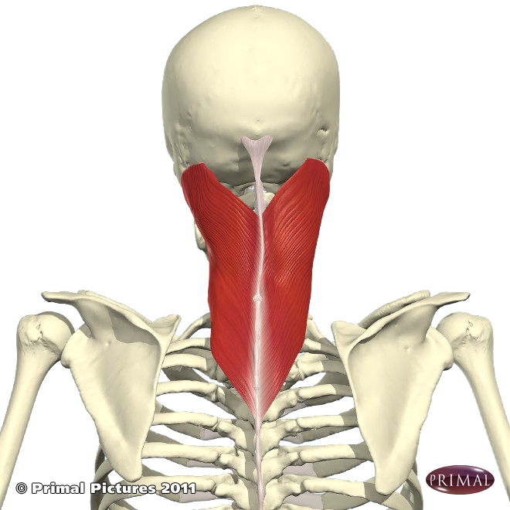
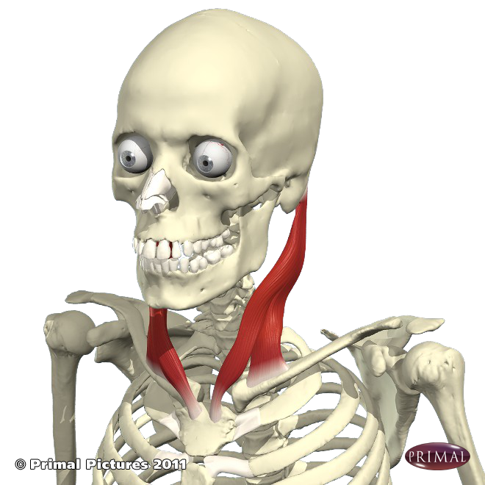
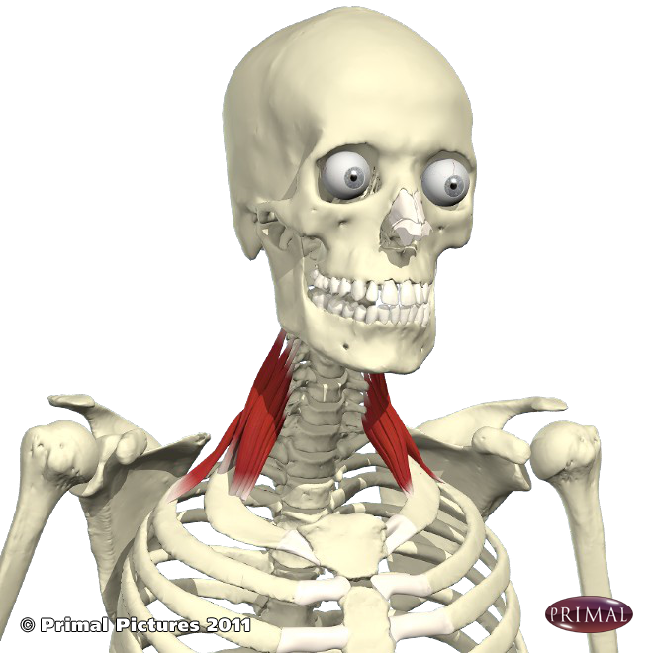
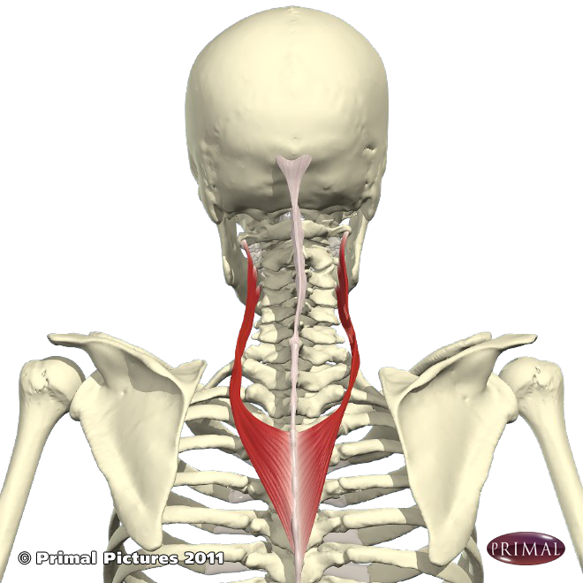
Muscles of the Neck
Sternocleidomastoid
Together they flex the head & neck
Individually they rotate the head and laterally flex the head to the same side
Scalenes
Together they flex the head & neck
Individually they laterally flex the head to the same side
Splenius Muscles
(capitas & cervicis)
Together each muscle extends the head & neck
Individually they laterally flex & slightly rotate the head to the same side

Slide 2
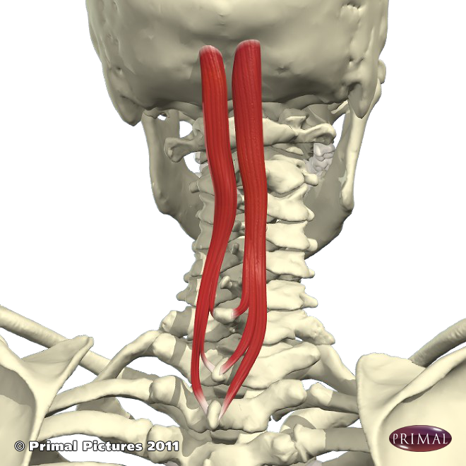
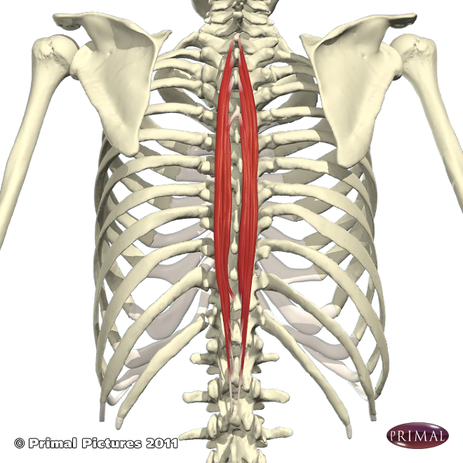
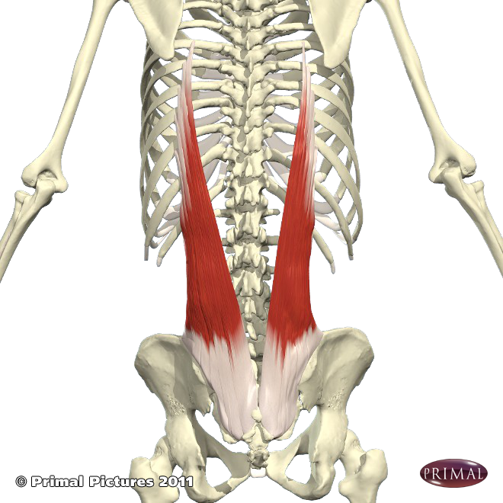
Muscles of the Vertebral Column…The Erector Spinae muscles
As their name suggests these muscles help to extend the spine and individually contribute to lateral flexion to the same side, those in the cervical thoracic region also contribute slightly to rotation of the vertebral column. [They used to be known as the sacrospinalis muscles.]
There are three sets of muscles, collectively known as the erector spinae, all running parallel to the vertebral column.
They vary in length so some are attached between one spinous or transverse process and the next, others attach to the sacral crest of the ilium, attaching to the ribs, or occipital bone.
As they run the length of the back of the body they are are stretched in forward bends and can tilt the pelvis forwards by pulling on the back of the ilium.
Backbends strengthen these muscles; without strength we tend to slouch, and if one side is weak there is a sideway bend, with the strong side standing out prominently along the side of the spine like a piece of rope.

Slide 3
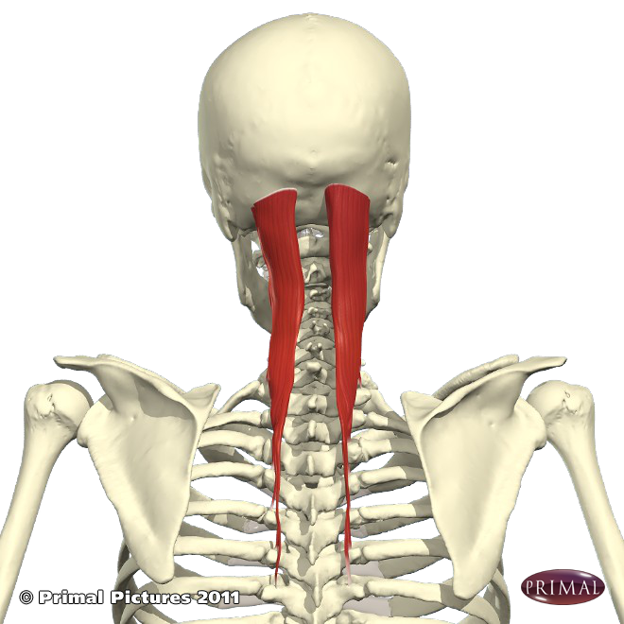
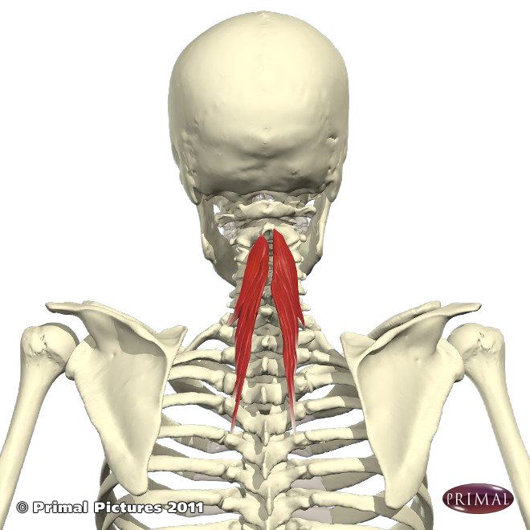
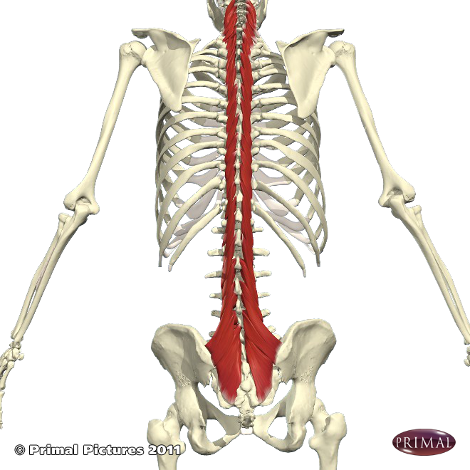
The Transversospinalis muscle group
This group of muscles help to extend the vertebral column and rotate to the same side.
Transversospinalis:
semispinalis capitis
Transversospinalis: semispinalis cervicis
Transversospinalis: semispinalis thoracis
They are small muscles which attach between individual vertebrae providing a stabilizing function for vertebrae, as well as contributing to extension and rotation.

Slide 4
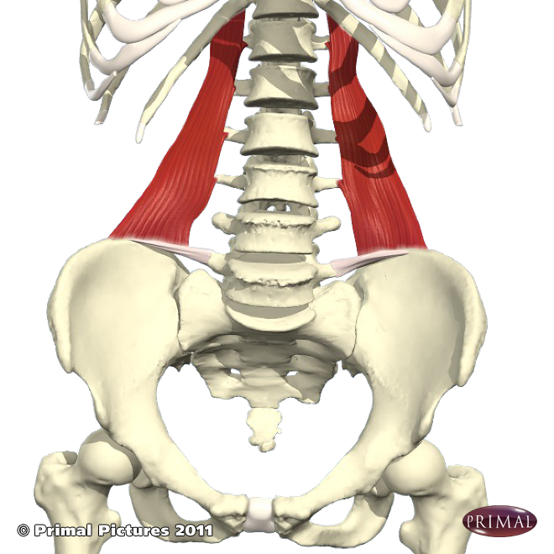
The Quadratus Lumborum
Along with the erector spinae & transversospinalis, the quadratus lumborum is the final muscle of the vertebral column.
It’s origin is at the top rear of the iliac crest and it inserts into the upper four lumbar vertabrae and the bottom rib.
It can assist with extension of the spinal column when both muscles are contracted and with lateral flexion when individually contracted.

