Slide 1
Muscles of the Shoulders, Arms & Hands
Use this in conjunction with the table called ‘Summary of muscles creating movement within the upper limbs’
To familiarize yourself with the names of the muscles
To provide a resource to see how the different muscles are attached to the bones and therefore how they can pull upon the bones to create specific movements

Slide 2
Wrist Flexors
These are situated within the anterior side (front or inner side of the forearm), originating from the medial epicondyle of the elbow joint, radius, ulna and interosseous membrane, inserting into the tendons of the anterior fingers.
Wrist Extensors
These originate at the lateral epicondyle of the elbow and the upper bones and interosseous membrane of the forearm forming an extensor compartment on the posterior side of the forearm (back of the forearm). Again they insert through tendons into the fingers on the posterior side of the hands.

Slide 3
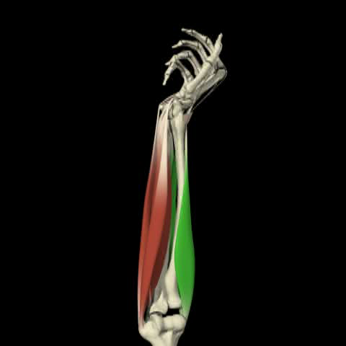
Flexion & extension of the hand at the wrist
Wrist flexors are located at the anterior side of the forearm
Wrist extensors are located at the posterior side of the forearm

Slide 4
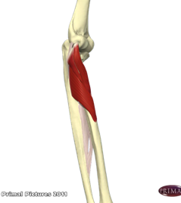
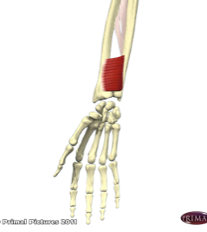
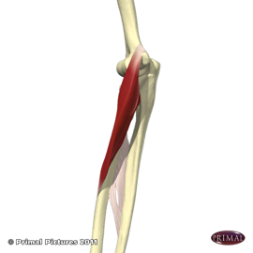
Supinator
Origin: lateral epicondyle of humerus Insertion: dorsal & lateral surfaces of upper third of radius
Action: supinates forearm
With synergist of biceps brachii
Pronator quadratus
Origin: anterior surface of distal part of shaft of ulna
Insertion: lower portion of anterior shaft of radius
Action: pronates forearm
Pronator teres
Origin: humeral head at medial epicondyle of humerus & ulnar head at medial border of coronoid process of ulna
Insertion: middle of lateral surface of radius
Action: pronates & flexes forearm
Fortunately these can be referred to simply as the supinators and pronators!

Slide 5
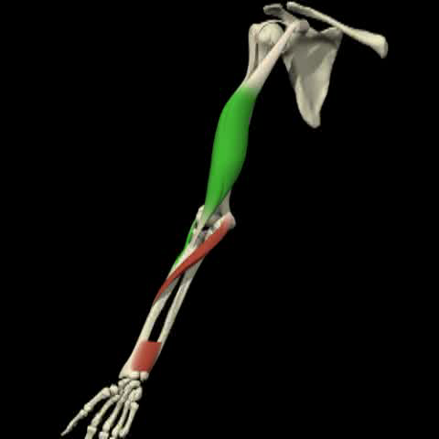
Supination & Pronation
Supinators:
Supinators & Biceps Brachii
Pronators:
Pronator Teres & Pronator Quadratus

Slide 6
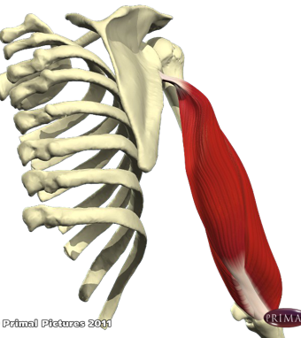
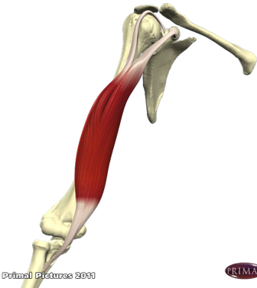
Triceps Brachii
Origin of three heads:
Long head from the inferior border of the glenoid of the scapula
Medial and short head from humerus
Insertion: posterior part of olecranon process of ulna
Action: extends forearm
Biceps Brachii
Origin of two heads:
Long head from top of glenoid of scapula curling over humeral head
Short head from coracoid process of scapula
Insertion: tuberosity of radius
Action: Flexion & supination of forearm
Tightness inhibits asana such as east stretch & weakness asana such as shoulderstand

Slide 7
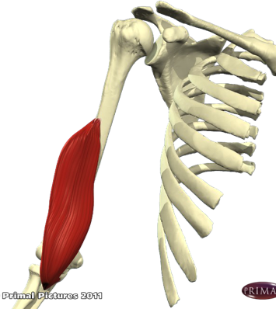
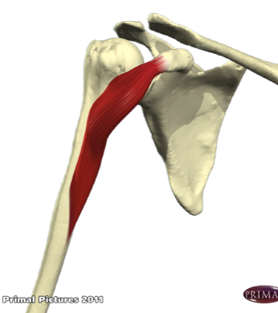
Brachialis
Origin: anterior of lower half of humerus
Insertion: tuberosity of ulna
Action: flexion of forearm
Coracobrachialis
Origin: tip of the coracoid process of scapula
Insertion: middle third of the medial surface and border of the humerus
Action: weakly adducts & stabilizes arm

Slide 8
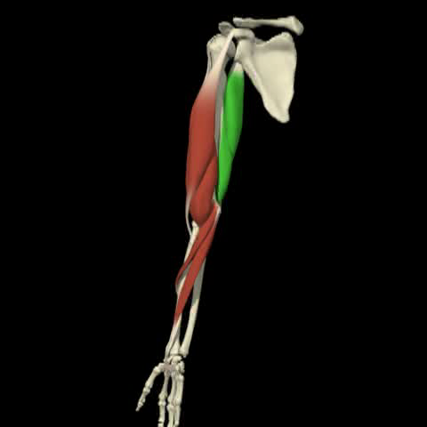
Flexion & extension of the forearm at the elbow
Forearm Flexors:
Biceps Brachii
Brachialis
Pronator Teres
Forearm Extensors:
Triceps Brachii

Slide 9
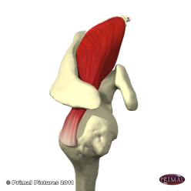
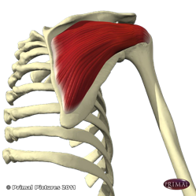
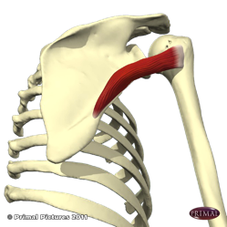
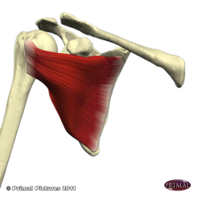
The four Rotator Cuff Muscles ‘Sits muscles’
Supraspinatus
Origin: supraspinous fossa
Insertion: upper part of greater tuberosity of humerus
Action: Abduct arms, draws humerus towards glenoid fossa
Infraspinatus
Origin: infraspinatus fossa
Insertion: middle part of greater tuberosity of humerus
Action: Abducts & externally rotates arm, draws humerus towards glenoid fossa
Teres minor
Origin: axillary border
Insertion: lower part of greater tuberosity of humerus
Action: externally rotates arm, draws humerus towards glenoid fossa
Subscapularis
Origin: subscapular fossa on anterior surface of scapula
Insertion: lesser tuberosity of humerus, ventral part
Action: internally rotates arm & stabilizes joint
Note that the SITS muscles depress the humeral head i.e. draw the head of the humerus towards the glenoid fossa meaning they stabilize the shoulder joint.

Slide 10
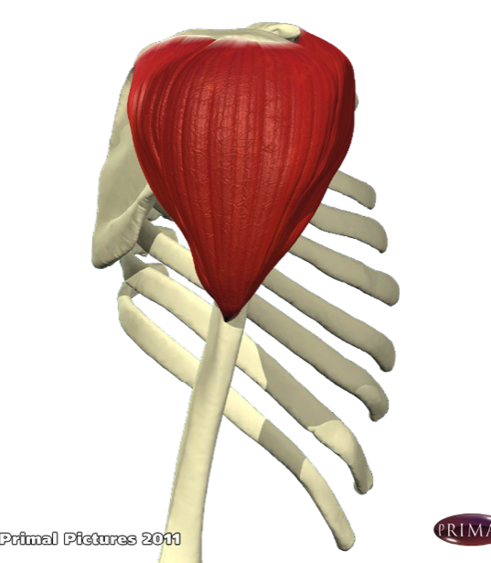
Deltoid
There are three distinct sections with different functions.
Origin:
Anterior: anterior border & superior surface of the lateral third of the clavicle
Middle: Lateral border of the acromion process
Posterior: lower border of the crest of the spine of the scapula
Insertion:
The deltoid tuberosity, middle, lateral surface of humerus
Action:
Anterior portion: flexes & internally rotates the arm
Middle portion: abducts arm
Posterior portion: hyperextends & externally rotates arm

Slide 11
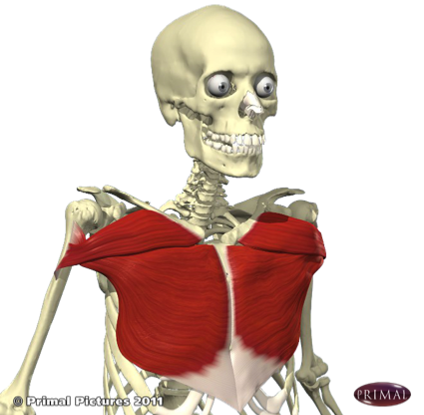
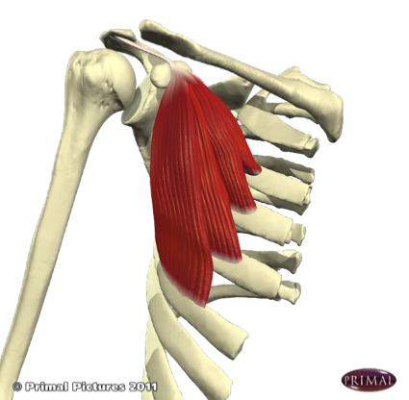
Pectorialis Major
Origin: Body of sternum & medial clavicle
Insertion: Proximal humerus
Action:
Adducts & internally rotates arm
Upper part flexes arm if fully extended
Lower part extends the flexed arm
Pectorialis Minor
Origin: 3rd, 4th and 5th ribs
Insertion: Coracoid process of scapulae
Action: Protracts and depresses scapulae
Raises ribs for forced inspiration

Slide 12
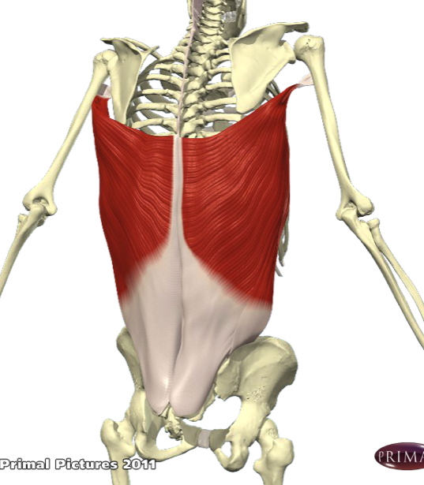
Latissimus Dorsi
Trans. as ‘broadest muscle of the back’
Origin:
Illiac crest, spinous processes of S1 to T7, lower 3 ribs and inferior angle of scapula
Insertion:
Medial side of humerus
Action:
Internally rotates and adducts arm
Extends arm from a flexed position
(Synergist role in extension & lateral flexion of the spine)
When tight limits overhead poses such as warrior 1 and the wheel

Slide 13
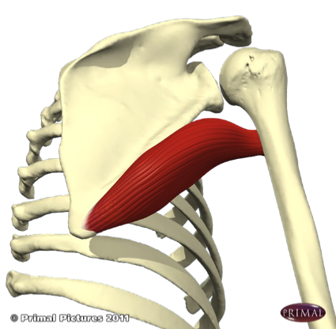
Teres major
Origin:
Lower third of the scapula, near inferior angle
Insertion:
Medial lip of bicipital groove of the humerus
Action:
Internally rotates arm
Adducts arm
Extends arm

Slide 14
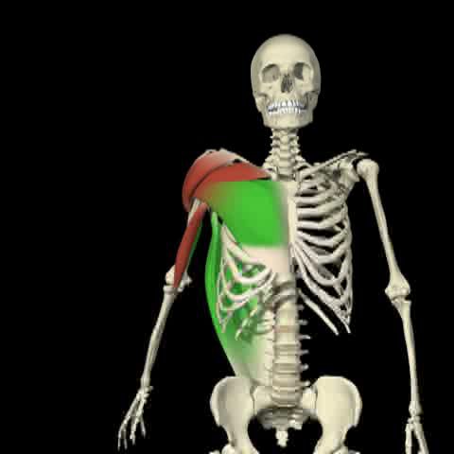
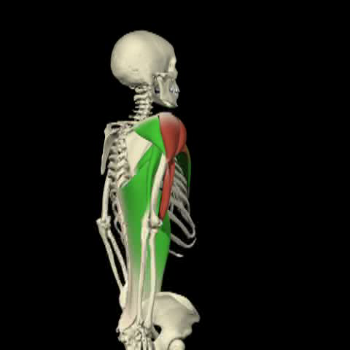
Flexion & Extension of the arm at the shoulder
Arms flexors:
Anterior Deltoid
Pectorialis Major (upper)
Biceps Brachii (weakly)
Coracobrachialis (weakly)
Arm extensors:
Posterior Deltoid
Latissimus Dorsi
Teres Major
Pectorialis Major (lower)

Slide 15
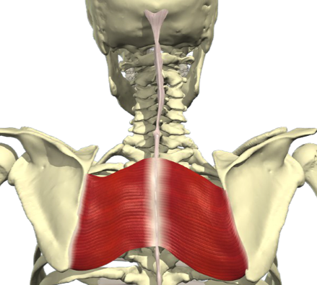
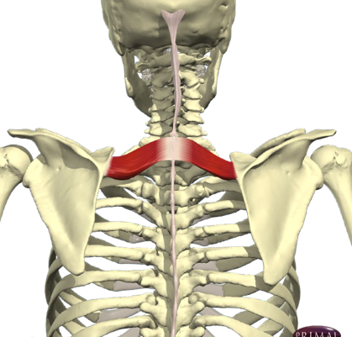
Rhomboids Major
Origin: Spinous processes of T2 to T5
Insertion: Medial to inferior border of scapulae
Action: Retracts & stabilizes scapulae
Rotates scapulae downwards
Assists in adduction of the arm
Rhomboids Minor
Origin: Spinous processes of C7 & T1
Insertion: Upper medial border
Action: Retracts & stabilizes scapulae
Elevates scapulae
Assists in adduction of the arm

Slide 16
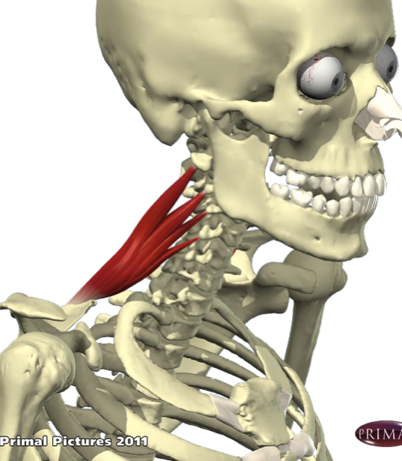
Levator scapulae
Origin:
Posterior tubercles of the transverse processes of C1 to C4
Insertion:
Medial border of the scapula at and above the spine
Action:
Retracts scapulae
Elevates scapulae
(Lateral flexion of neck)

Slide 17
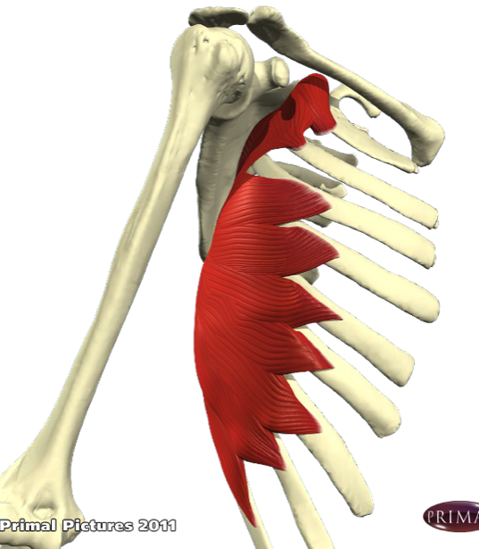
Serratus Anterior
Origin:
Outer surface and superior border of top 9 ribs
Insertion:
Medial border of scapulae
Action:
Protracts scapulae & assists scapula rotation (to help with abduction & flexion of the arm)
Helps with stability of scapulae

Slide 18
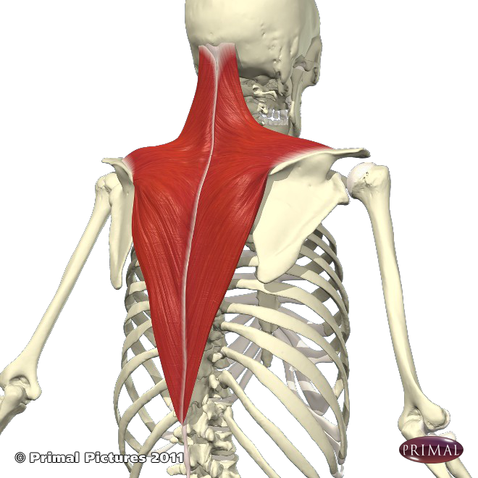

Trapezius
Broad triangular shape
Origin:
Base of skull, posterior ligaments of neck and spinous processes of C2 to T12
Insertion:
Posterior clavicle & superior spine of scapulae
Action: there are 3 functional areas:
Upper: elevates and rotates scapulae upwards
Middle: retracts scapulae
Lower: Depresses scapulae & provides postural support for lower back
Weakness limits strength whether arms lifted above the head or in weight bearing poses

Slide 19
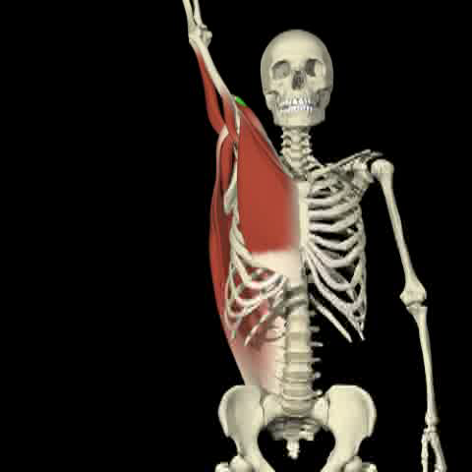
Abduction & Adduction of the arm at the Shoulder
Arm Abductors
(away from the midline):
Middle deltoid (assisted by the trapezius & rhomboids
which rotate the scapula)
Supraspinatus
Teres Minor
Arm Adductors
(towards the midline):
Latissimus Dorsi
Pectorialis Major
Teres Major
Coracobrachialis (weakly)
Long head Triceps Brachii (weakly)

Slide 20
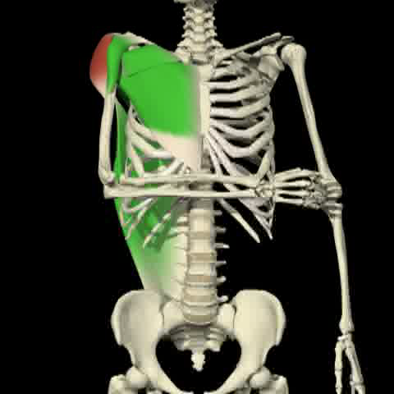
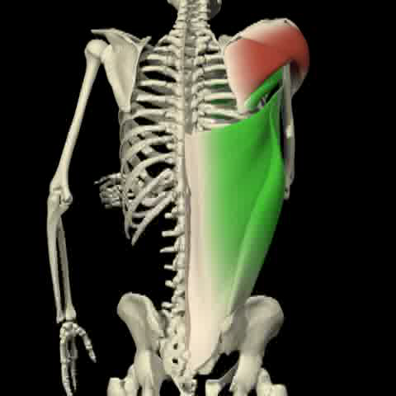
External & Internal rotation of the arm at the shoulder
External (lateral) arm
rotators:
Posterior deltoid
Infraspinatus
Teres Minor
Internal (medial) arm
rotators:
Latissimus dorsi
Anterior Deltoid
Pectorialis major
Teres Major
Subscapularis

Slide 21
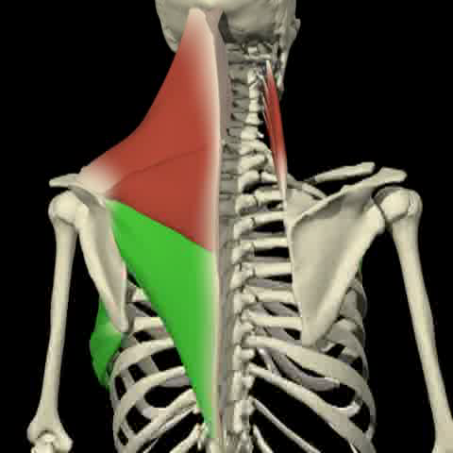
Elevation & depression of the scapulae
Scapula elevators:
Upper Trapezius
Levator Scapulae
Rhomboid Minor
Scapula Depressors:
Lower Trapezius
Serratus Anterior

Slide 22
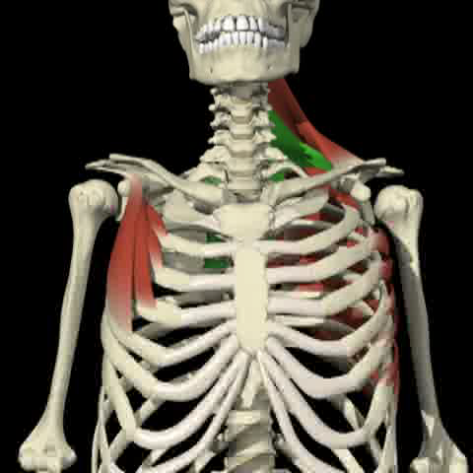
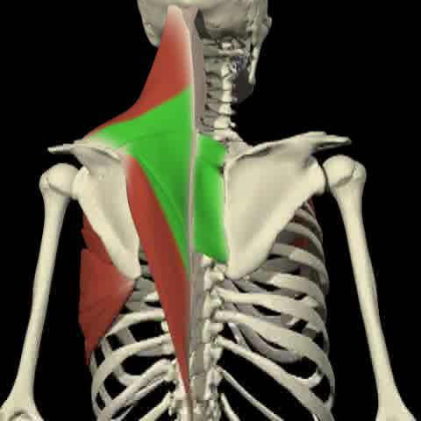
Protraction & retraction of the scapulae
Scapula protractors (abducts):
Serratus anterior
Pectorialis minor
(helps with flexion and abduction of the arm)
Scapula retractors (adducts):
Middle trapezius
Rhomboids
Levator scapulae
Main stabilizers of scapula: Serratus Anterior & Rhomboids

Slide 23
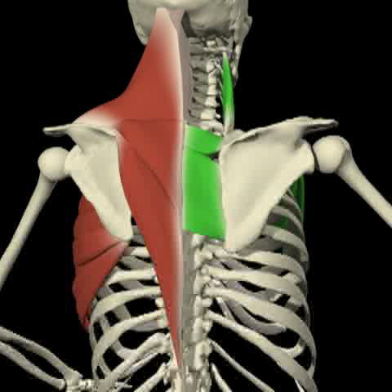
Upwards & Downwards Rotation of the scapulae
Upwards scapula rotators:
Upper & Lower Trapezius
Serratus Anterior
(Upwards scapula rotation assists in full flexion of the arms overhead, once in these asana such as vrksasana the scapulae are retracted & depressed)
Downwards scapula rotators:
Rhomboids Major & Minor
Levator Scapula
(Downwards scapula rotation aids us in many weightbearing asana such as chataranga dandasana where the scapulae will also retract & depress)

