Slide 1
Muscles of the Hips, Knees, Ankles and Feet

Slide 2
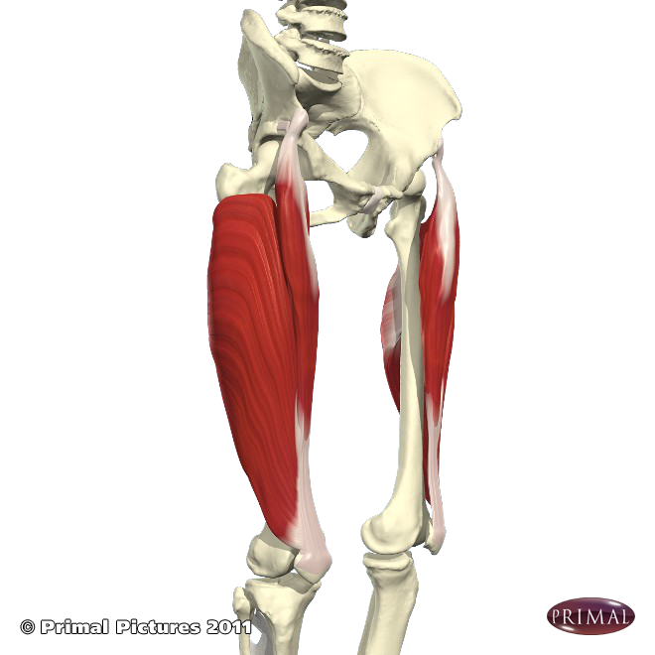
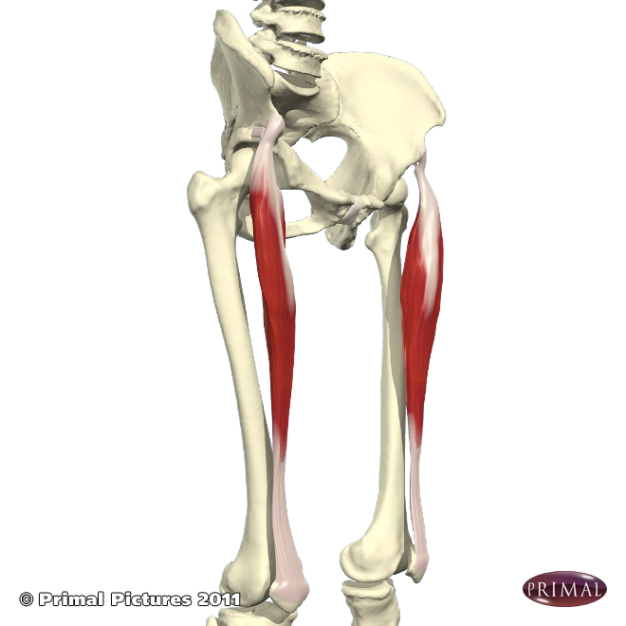
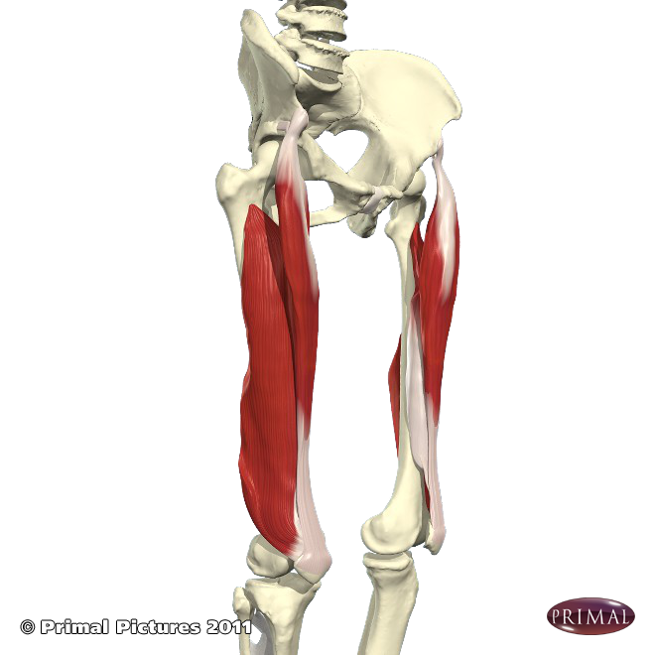
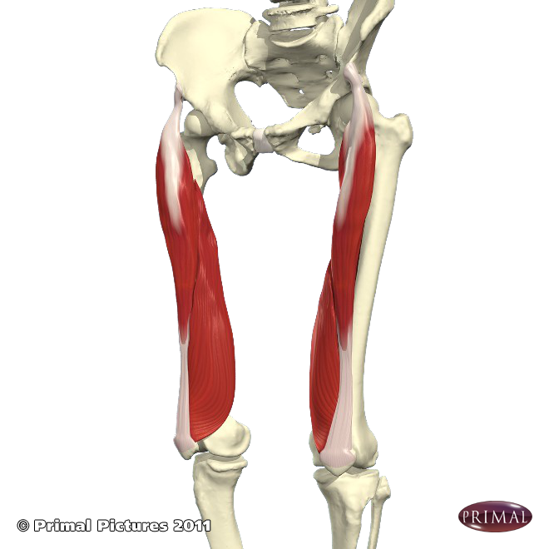
Quadriceps
1
4
There are are four quadriceps:
Vastus lateralis
Vastus intermedialis
Vastus medialis
Rectus femoris *
1 – 3 originate on the pelvis and attach to the patella tendon. They all assist in extension of the knee
The rectus femoris also originates on the pelvis but additionally crosses the knee joint through the quadratus femoris tendon meaning it crosses over two joints, it can extend the lower leg at the knee and also flex the leg at the hip.
Strong quadriceps protect the knee joint.
2
3

Slide 3
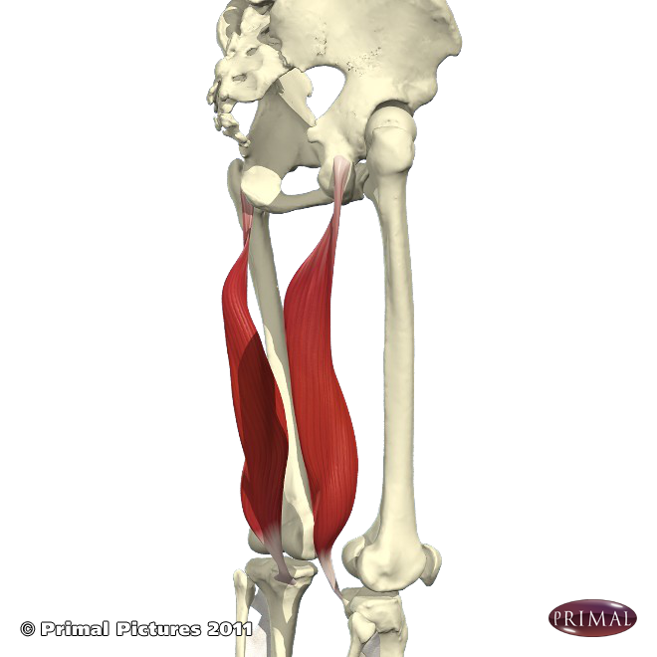
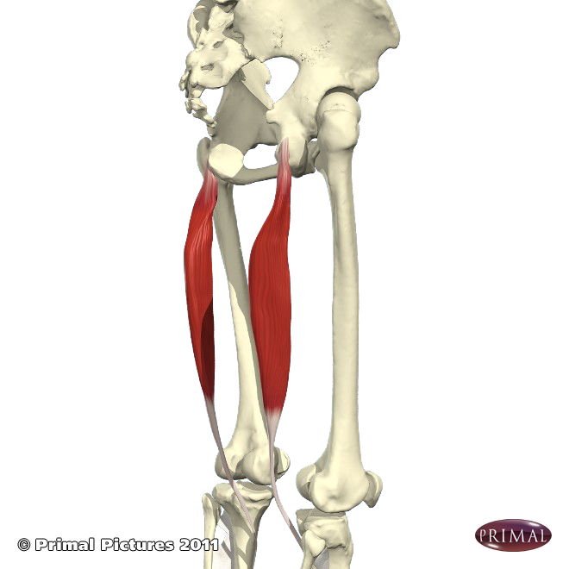
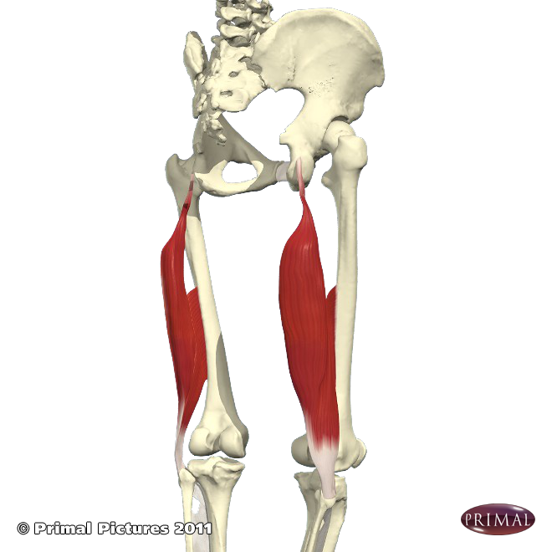
Hamstrings
Semimembranosus Semitendinosus Biceps femoris
Collectively the hamstrings flex the knee joint as they cross the knee and insert into the tibia & fibula. The semimembranosus & semitendinosus also help to medially rotate the leg at the hip.
Because they all originate from the ischial tuberosities of the hip bone (aka the ‘sitting bones’) when tight they can inhibit forward bending; this is because the pelvis must be able to rotate anteriorly (forwards) so the whole spine can move as one length, and when the hamstrings are tight this becomes impossible often creating excessive pressure in the lower back region.

Slide 4
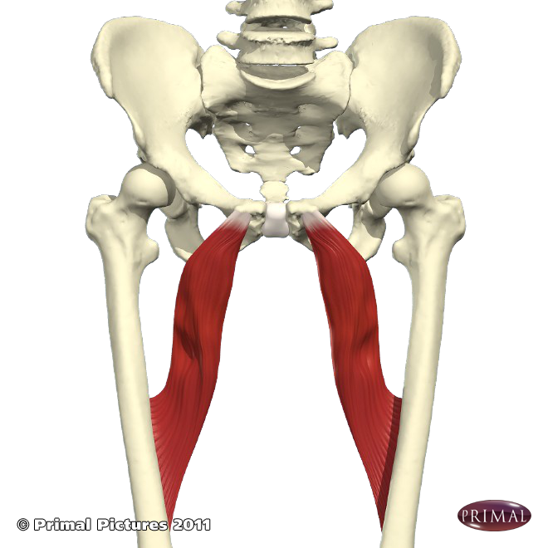
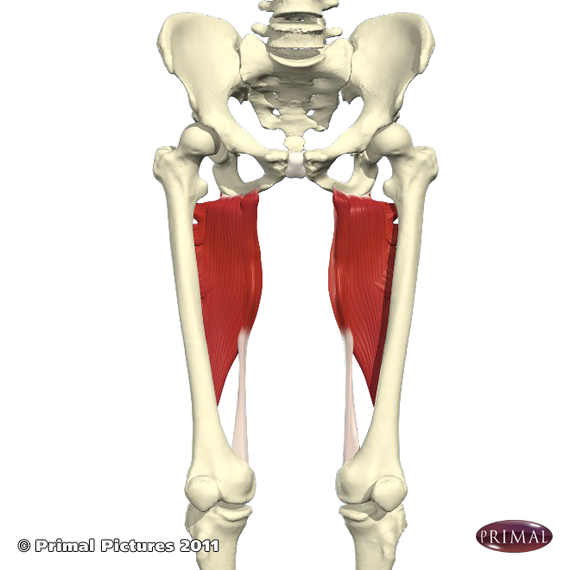
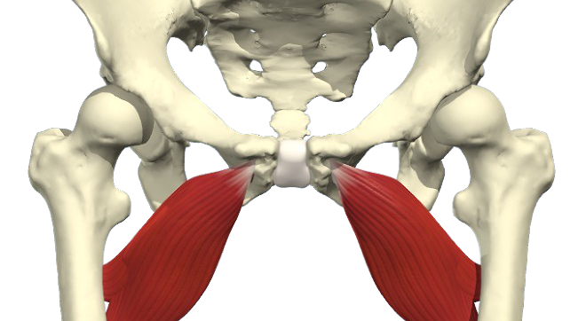
Adductors
Adductor magnus
Collectively the adductor muscles originate near the pubis and insert into the medial femur. They adduct legs (draw them inwards) and assist with medial rotation.
When tight they reduce our ability to work in spread leg poses or cross legged poses and because one of the adductors, the adductor magnus, attaches to the ischial tuberosities (like the hamstrings) when tight it also inhibits forward bending.

Slide 5
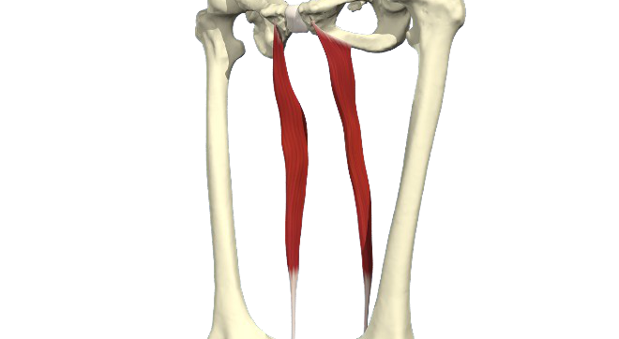
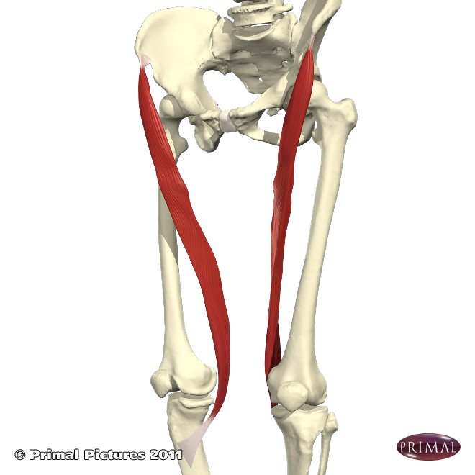
The gracilis and sartorius
The gracilis has its origin at the pubis and inserts into the medial tibia, working across the hip and knee joints.
It helps to flex the knee, medially rotate the leg at the hip and weakly adducts the leg at the hip.
The sartorius has its origin at the anterior superior (front, top) iliac crest and inserts into the medial tibia and also crosses both the hip and knee joint.
However whilst it also flexes the knee joint, it laterally rotates and abducts the leg at the hip joint.
When the knee is flexed it can assist with medial rotation at the hip

Slide 6
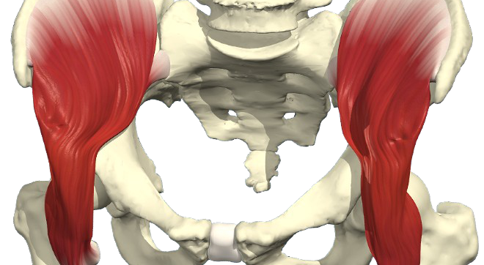
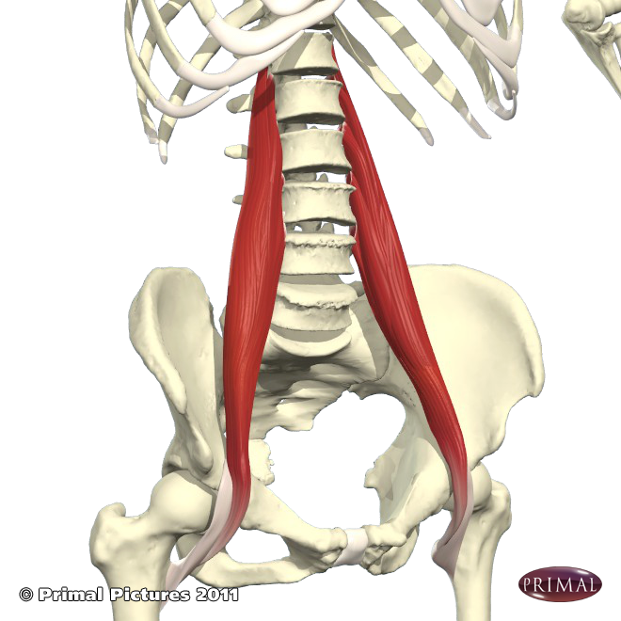
Iliopsoas Muscle
This muscle is formed from the iliacus and the psoas muscles.
Together they flex the leg at the hip and when the insertion (i.e. the femur) is fixed they can flex the trunk & pelvis forwards. They can medially rotate the leg at the hip and the psoas portion can also help to laterally flex the spine.
Often it is known as an emotional muscle because it can become tight when stressed. This is thought to be because this muscle would get us ready to run away when the fight or flight response has been activated. When tight it can create chronic back pain.
Iliacus
PsoasMajor

Slide 7
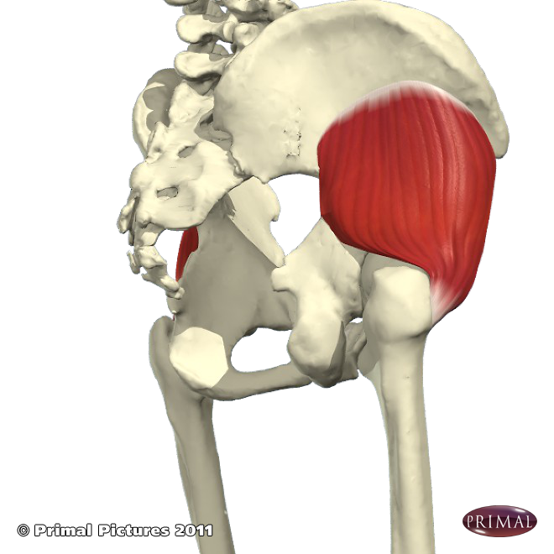
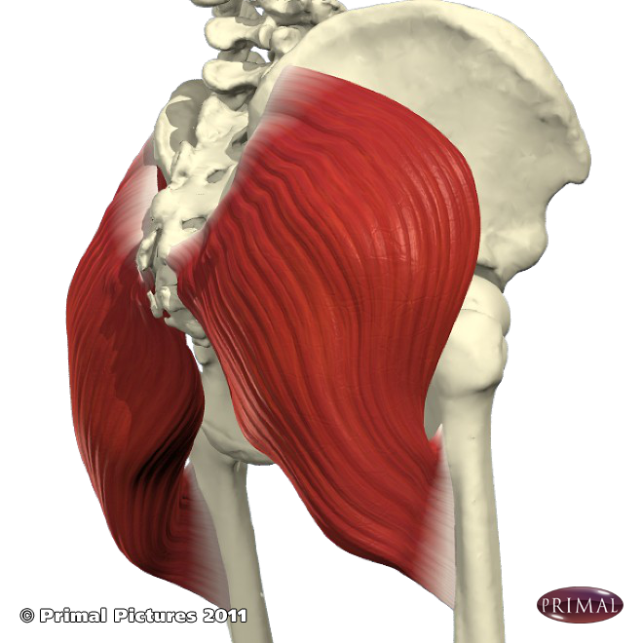
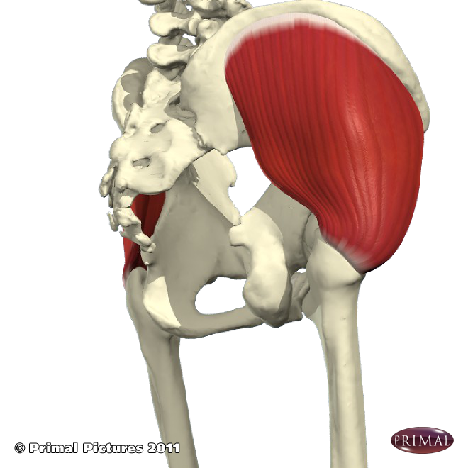
Gluteal Muscles
Gluteus Minimus Gluteus Maximus Gluteus Medius
The gluteals are the large buttock muscles which attach to hip bone and into the femur.
The gluteus minumus and maximus work together to create extension, abduction and lateral rotation of the leg at the hip whereas the gluteus medius also abducts the leg but medially rotates the leg at the hip joint.
Thankfully, whatever the movement, generally they are simply referred to as the gluteus muscles or ‘glutes’.

Slide 8
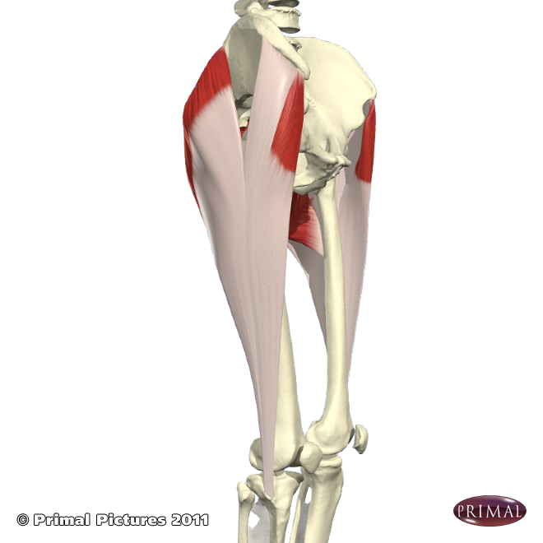
Tensor Fascia Latae
The Tensor Fascia Latae is located on the anterolateral (front side) of the thigh crossing the hip and knee joint.
Its origin is at the iliac crest and it inserts into the iliotibial tract at the side of the tibia.
It assists extension of the lower leg at the knee.
It also flexes, medially rotates and abducts the leg at the hip.

Slide 9
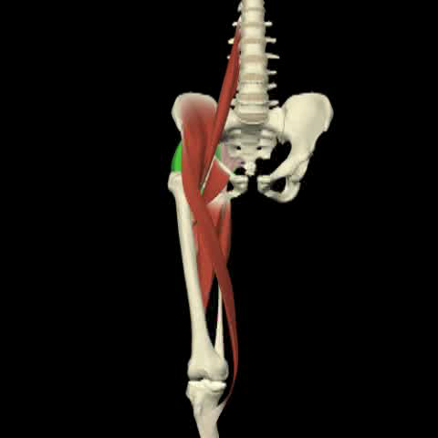
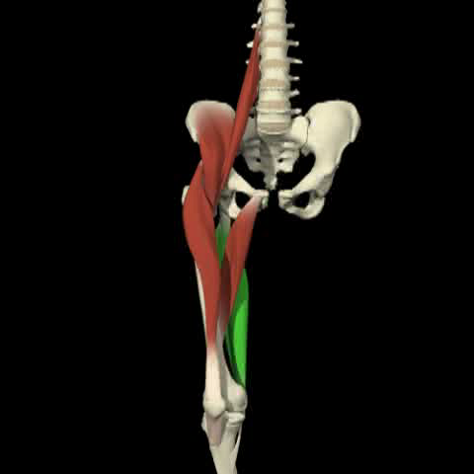
Flexion & extension at the hip
Flexors of leg at the hips:
Iliopsoas
Adductors
Rectus Femoris
Sartorius
Tensor Fascia Latae
Extensors of leg at the hips:
Hamstrings
Gluteus Maximus
Note: The hamstrings also need strengthening as well as becoming more flexible

Slide 10
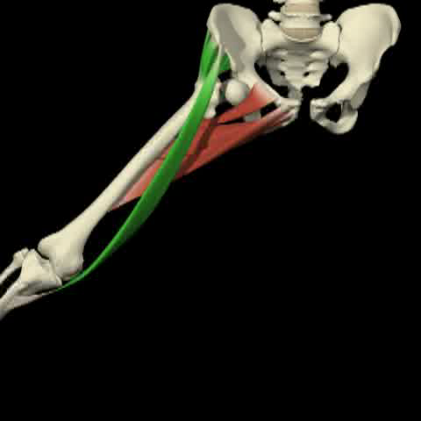
Abductors & Adductors of the hips
Abductors:
Gluteus Maximus, Medius & Minimus
Sartorius
Tensor Fasica Latae
Adductors:
Adductors
Pectineus
Gracilis (weakly)

Slide 11
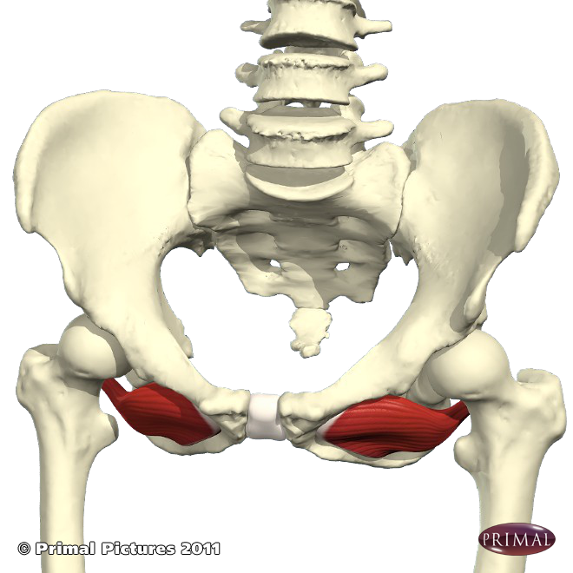
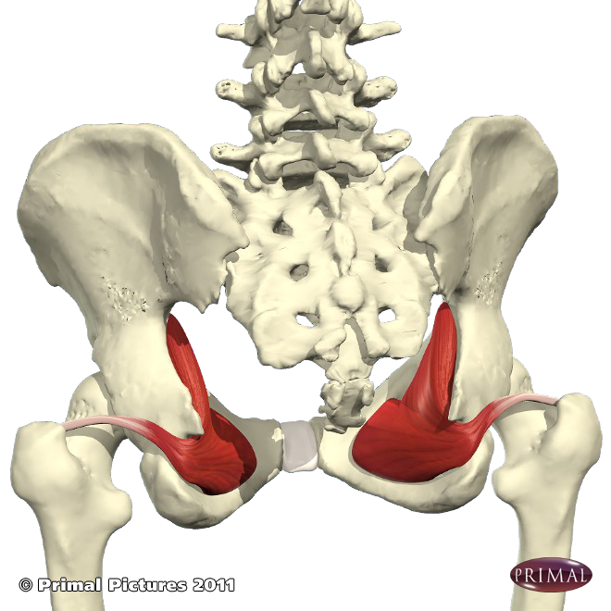
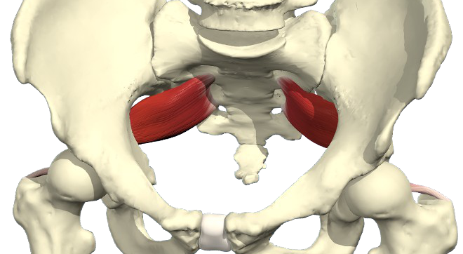
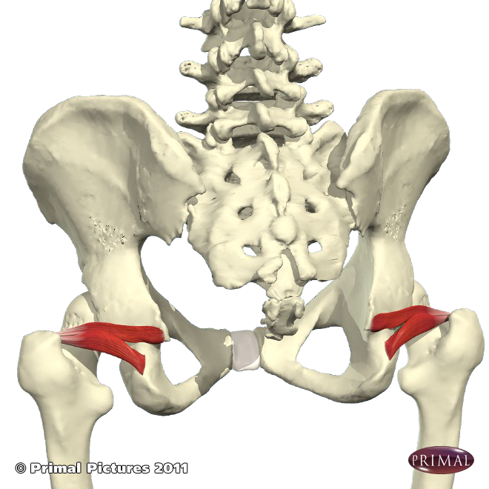
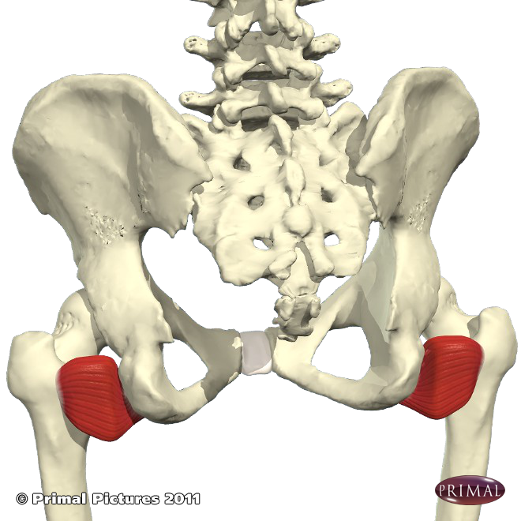
External Hip Rotators (6)
Piriformis* Obturator Externus Obturator Internus
These six deep external rotators work along side the gluteus maximus. The piriformis is considered to be the main external hip rotator as it is the only one attached to the sacrum (i.e. the spine) as well as to the femur.
When the piriformis is tight it can impinge upon the sciatic nerve creating sciatica; here there can be pain in the buttocks and sacral region as well as numbness and tingling down into the legs.
Gemellus Superior & Inferior
Quadratus Femoris

Slide 12
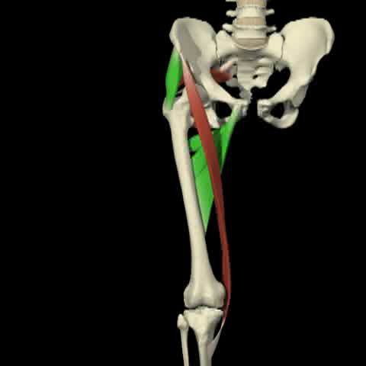
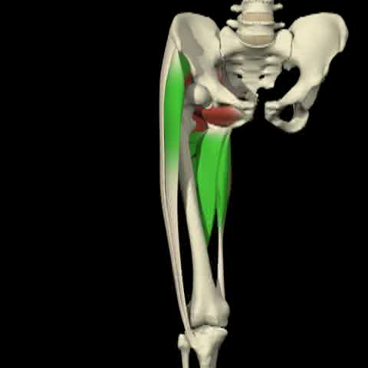
External & Internal Rotators of the hip
External rotators of leg at hips:
Gluteus Maximus & Minimus
Deep External Hip Rotators
Sartorius
Internal rotators of leg at hips:
Gluteus Medius
Adductors
Tensor Fascia Latae
Gracilis & Sartorius (when knee flexed)

Slide 13
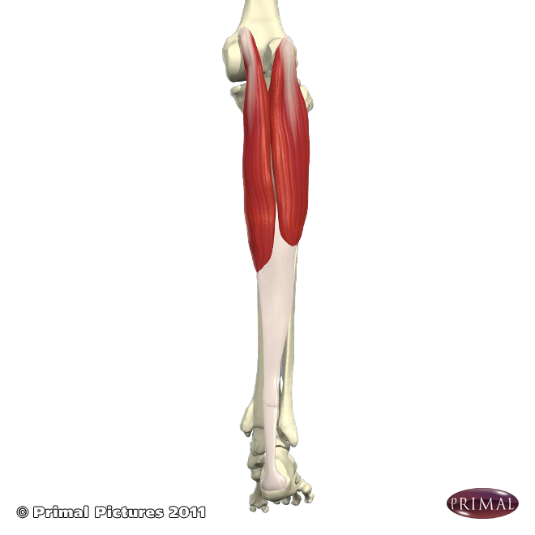
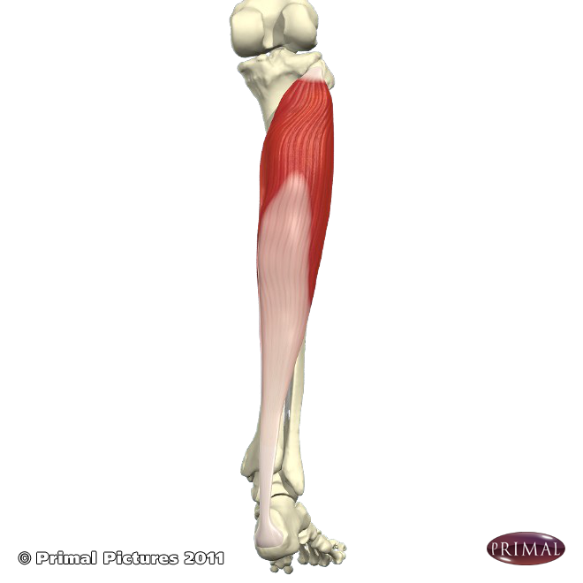
Calf Muscles
The gastrocnemius originates at the medial & lateral condyles of the femur and inserts via the achilles tendon into the heel bone.
It flexes the lower leg at the knee and plantarflexes the foot at the ankle (i.e. points the foot). If weak the knees can be hyperextended.
The soleus originates at the proximal lateral tibia and inserts via the achilles tendon into the heel bone. It lies beneath the gastrocnemius.
It only crosses the ankle joint and can plantarflex the foot at the ankle.

Slide 14
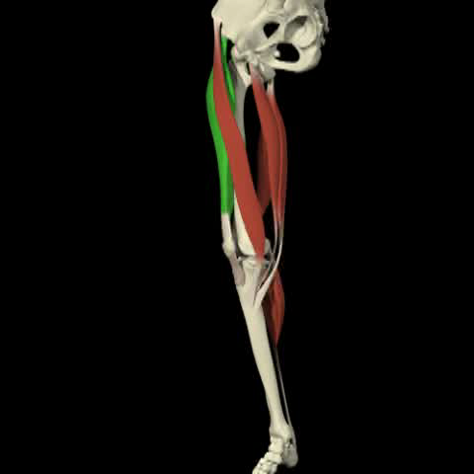
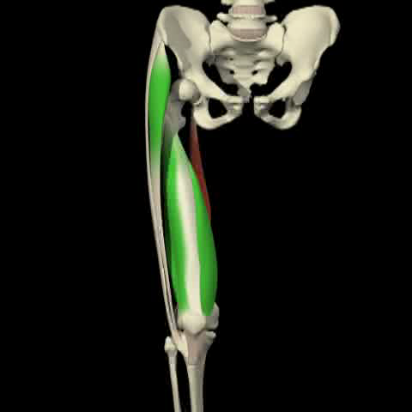
Flexion & Extension at the knee
Knee flexors:
Gastrocnemius
Plantaris
Popliteus
Gracilis
Hamstrings x3:
Biceps femoris
Semitendinosus (requires flexion @ hip first)
Semimembranosus (requires flexion @ hip first)
Knee extensors:
Quadriceps x 4
Tensor Fascia Latae

Slide 15
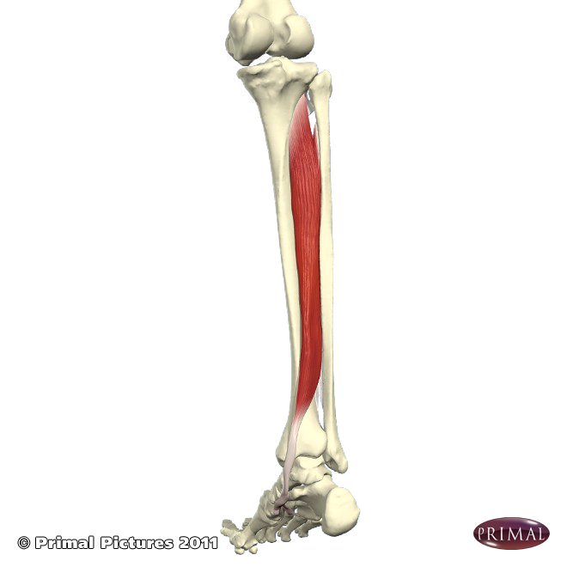
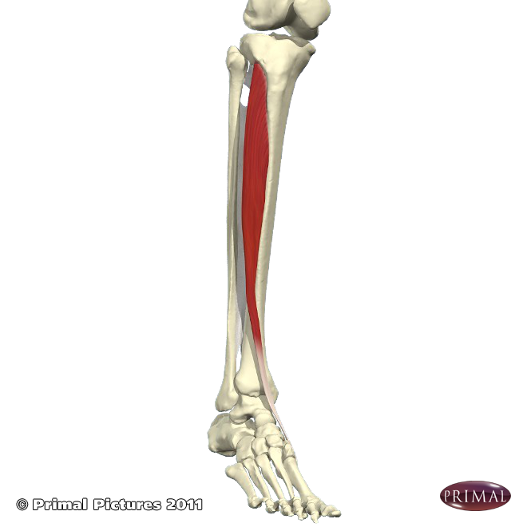
The Posterior Tibialis originating at the back of the tibia and fibula and inserting into the medial metatarsal and tarsal bones creates plantarflexion of the foot at the ankle.
It also inverts the foot; weakness creates a rolling inwards and instability of the ankle.
It is assisted by the Flexor Hallucis Longus & Flexor Digitorum Longus
The Anterior Tibialis originates at the proximal anterior lateral tibia and inserts into the medial edge of the foot, around two inches from the big toe. It dorsiflexes and inverts the foot.
This is the muscle associated with shinsplints.
It is assisted by the Extensor Hallucis Longus & Extensor Digitorum Longus

Slide 16
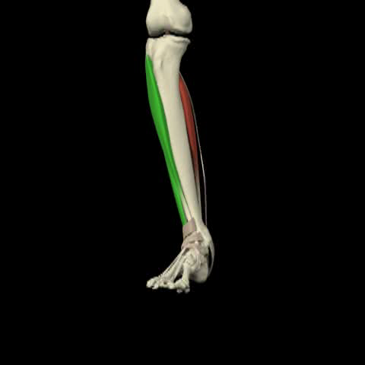
Movement at the ankle
Plantarflexion:
Posterior Tibialis
Flexor Hallucis Longus
Flexor Digitorum Longus
Gastrocnemius
Soleus
Dorsiflexion:
Anterior Tibialis
Extensor Hallucis Longus Extensor Digitorum Longus

Slide 17
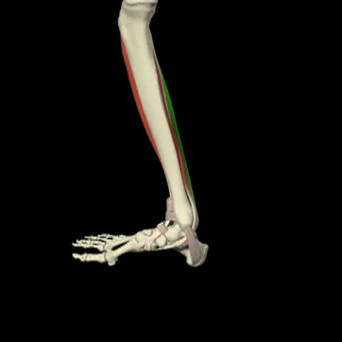
Inversion & Eversion of the Foot
Inversion:
Anterior & Posterior Tibialis
Extensor Hallucis Longus
Flexor Hallucis Longus
Flexor Digitorum Longus
Eversion:
Extensor Digitorum Longus
Peroneus Longus
Peroneus Brevis

