Slide 1
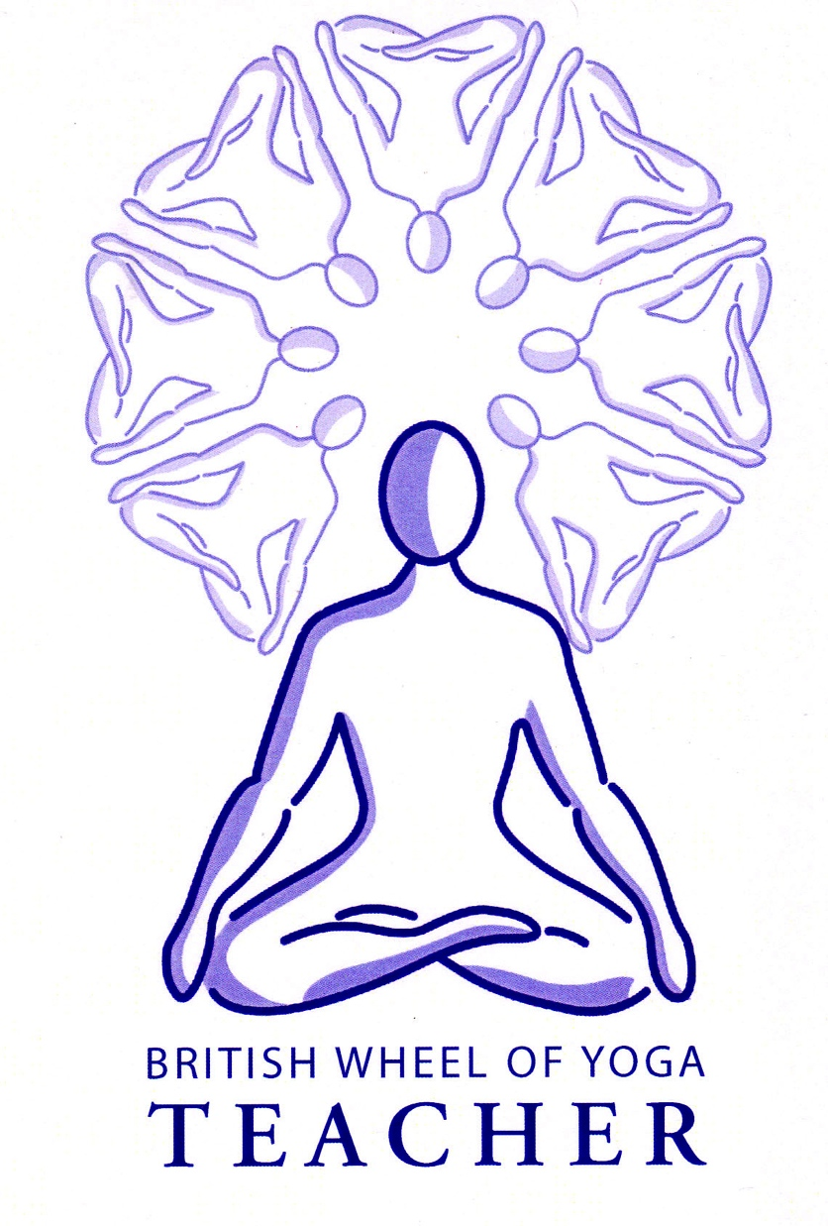
Basic Breathing
& the muscles of the respiratory system

Slide 2
Basic breathing techniques enable our students to…..
Utilize the primary respiratory muscles rather than the secondary muscles (more later) so breathing is efficient and does not cause strain
Become aware of the quality of the breath, noticing its pace, depth & the different parts of the breath i.e. the puraka, rechaka & kumbhaka (inhalation, exhalation & retention
Recognize a relaxed effortless natural breath,
Gradually dismantle habitual patterns of dysfunction
Appreciate how a calm breath creates a calm mind and body
Gradually learn to witness without the need to control what is being observed

Slide 3
Some special benefits of basic breathing practices:
Removes accumulated tension in the neck, shoulders, jaw and face ~ good for all of us and great for headache/migraine sufferers
Reduces back pain as the movement of the diaphragm massages the spinal column and the abdominal muscles are toned
Alleviates hypertension & eases heart conditions as the heart is massaged by the movement of the diaphragm; the heart is attached to the tissue fascia of the diaphragm so that the vena cava piercing the diaphragm is opened, increasing blood flow back to the heart.
Improves the acid to alkaline balance of the body ~ good for diabetes
Encourages a proper exhalation ~ good for asthmatics
Massages all viscera improving functioning
Calms the mind and the nervous system so alleviates anxiety and stress which is good for all conditions and for general wellbeing!

Slide 4
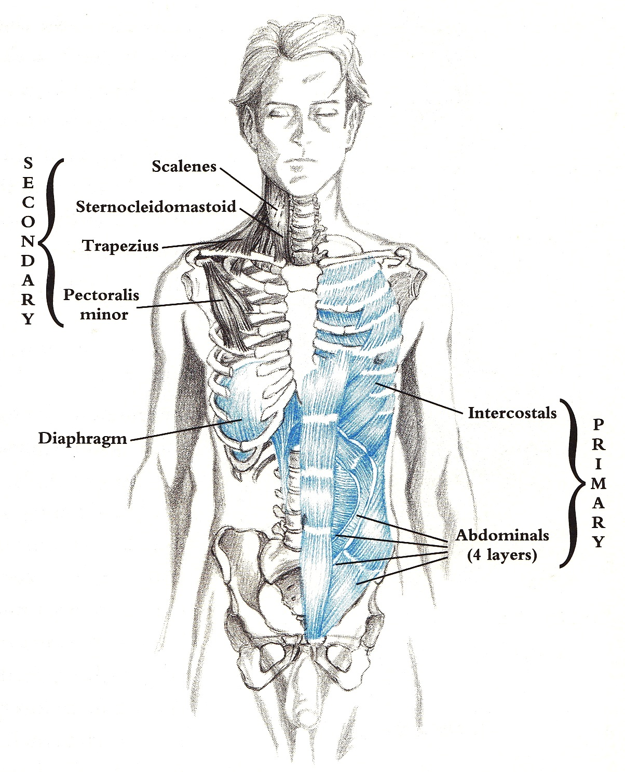
The respiratory muscles
The primary respiratory muscles are the diaphragm, abdominals & intercostals. They are designed for the job being very large and strong, and able to work tirelessly over 22,000 times per day.
Indeed the diaphragm is responsible for 75% of all respiratory effort.
The secondary muscles are smaller and more delicate, able to work for shorter periods, otherwise if overused they finally become taut and then exhausted.
In addition the primary muscles are lower in the body which give us a feeling of being grounded and open to our ‘gut- feelings’, whereas using secondary muscles instead we will feel less stable and more ‘in the head’, being unable to connect with our body and our feelings.

Slide 5
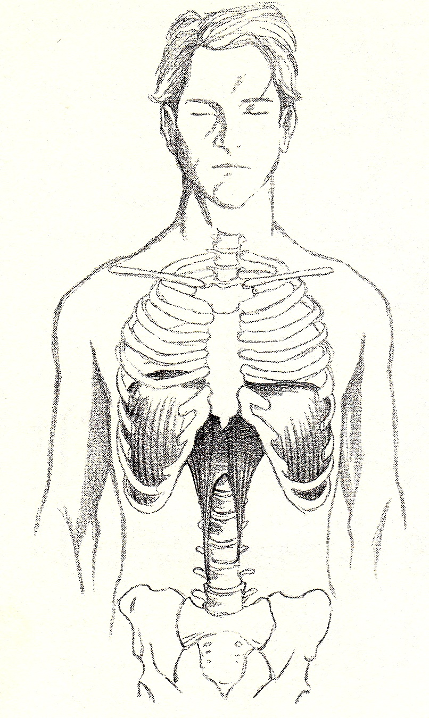
The mechanics of breathing & the movement of the diaphragm
As we inhale the diaphragm descends, and widens and the sternum & ribcage lift and expand, increasing the volume in internal air passages. So now the outside air pressure is greater than internal air pressure and air rushes inwards.
Then as the diaphragm & intercostals relax, recoiling to their original shape, the pressure in the internal air passages increases until it is greater than the outside air, so that air rushes out and we exhale.
In essence air movement is created by pressure differentials where gases move from high pressure to low pressure.
Note: the more we need oxygen the more fully the intercostals and abdominal muscles are activated to aid exhalation.
The diaphragm is a double domed shape parachute like structure attached to the xiphoid process, inner cartilage of 7th to 12th ribs and down the anterior spine to L1 to L4. The crura or anchor like tendons mean the diaphragm can move structures as far down as the tailbone.

Slide 6
Teaching basic breathing
Introduce this element of yoga right from the very start
Keep it short and repeat the same technique for several sessions; return to it periodically
Gradually increase the duration & complexity
Can be taught at the start of a class, where it is excellent to raise breath awareness and take focus inwardly, at a suitable point during asana practice, before relaxation or even upon leaving a relaxation
Avoid giving expectations meaning it is often better to treat as an inquiry or exploration
Give some theory behind the practices so students better understand why it is being practiced

Slide 7
Examples of basic breathing techniques
Three-part Yogic Breath ‘yogic breath’
Variations on the above e.g.
  Bring arms up from the floor, vertical, 45º overhead, along ground behind head
  Feeling air moving into front-sides-back of abdomen, ribcage, upper chest
Direct attention to places where the breath can be experienced e.g. Air at nostrils, abdomen, traveling to and fro lungs and so on, feeling:
  Temperature
  Texture etc.
Co-ordinate the breath with simple movements
Link the breath to simple visual images e.g. a swinging pendulum
Link the breath to sounds e.g. sound of the tides, simple mantra (so hum..)
Use hasta mudras where breathing is subtly altered
Use the hathenas, simple poses where different areas of the respiratory system are accentuated

Slide 8
Remember:
We should never overlook the importance of basic breathing techniques for our students
&
“free breathing is a result of deep relaxation not of effort” D. Farhi
All images taken from Farhi, Donna (1996) The Breathing Book, Henry Holt & Co: New York

